Slide 1
FLIGHT BOOKING APPLICATION
TEAM MEMBERS:
1.SURAKSHA M (211521104164)
2.SREYA S (211521104155)
3.YAMINI K (211521104184)
4.SOWMIYA R (211521104153)

Slide 2
TABLE OF CONTENTS
ABSTRACT
INTRODUCTION
PROPOSED SYSTEM
IMPLEMENTATION OF MERN STACK
1.FRONTEND
2.BACKEND
3.INTEGRATION
BLOCK DIAGRAM
MODEL SCREENSHOT
CONCLUSION

Slide 3
ABSTRACT
The Flight Booking Application is a full-stack MERN (MongoDB, Express.js, React, Node.js) web application designed to provide a centralized platform designed to simplify the process of searching, comparing, and booking flights. ensures a seamless travel planning experience with a robust and scalable architecture. Access flights from various airlines worldwide. Notifications on flight delays or cancellations keep users informed, while a waiting list feature enables users to be notified when seats become available on booked-out flights.

Slide 4
INTRODUCTION
Introducing our flight booking app, built using the MERN stack (MongoDB, Express.js, React, and Node.js) for a powerful and responsive user experience. This app simplifies the flight search and booking process, allowing users to easily compare options from various airlines. With a sleek, intuitive interface, travelers can filter flights by price, duration, and more. Real-time updates ensure users are informed about flight statuses and exclusive deals.

Slide 5
PROPOSED SYSTEM
The flight booking app leverages the MERN stack to provide a robust and dynamic platform for travelers.
The MongoDB database ensures efficient data storage and retrieval of flight information and user profiles.
Express.js serves as the backend framework, handling API requests and facilitating seamless communication between the server and client.
The React frontend offers a responsive and engaging user interface, allowing users to search, filter, and book flights effortlessly.
Node.js powers the server-side logic, ensuring fast performance and scalability as user demand grows. Together, these technologies create a comprehensive system that enhances the travel booking experience while maintaining security and reliability.

Slide 6
IMPLEMENTATION OF MERN STACK FRONTEND
Key components like `Flight Search`, `Flight List`, and `Flight Booking` allow users to quickly find and book flights with forms, dropdowns, and interactive date selectors.
Using `react-router-dom`, users can seamlessly navigate between pages, including the home page, search results, and booking details.
State management is handled using React's `useState` and `useEffect`, while more complex states like user authentication are managed with the Context API or Redux for a smooth experience

Slide 7
BACKEND
The backend of the MERN stack flight booking app is built with Node.js and Express.js to create a RESTful API for handling requests.
MongoDB serves as the database, storing user profiles, flight details, and booking records, with Mongoose used for schema modeling and database interactions.
Authentication and authorization are managed with JWT (JSON Web Tokens) to ensure secure login and data access for registered users.

Slide 8
INTEGRATION
The frontend (React) communicates with the backend (Node.js/Express) through HTTP requests to RESTful API endpoints.
MongoDB serves as the database for storing and managing data such as user accounts, flight details, and booking records.
Real-time features can significantly improve user experience by providing live updates on flight availability, booking status, and pricing.

Slide 9
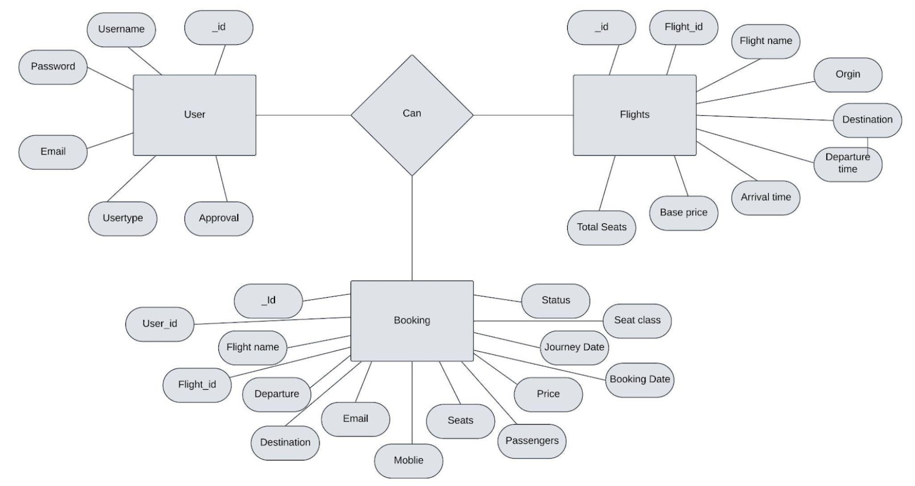
BLOCK DIAGRAM

Slide 10
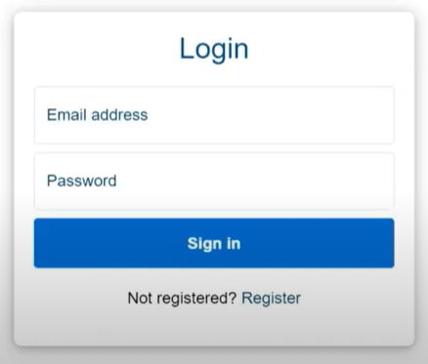
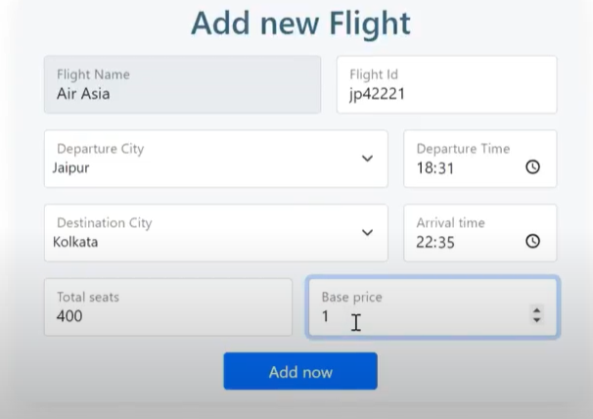
MODEL SCREENSHOT

Slide 11
THANK YOU !

